Slide 1
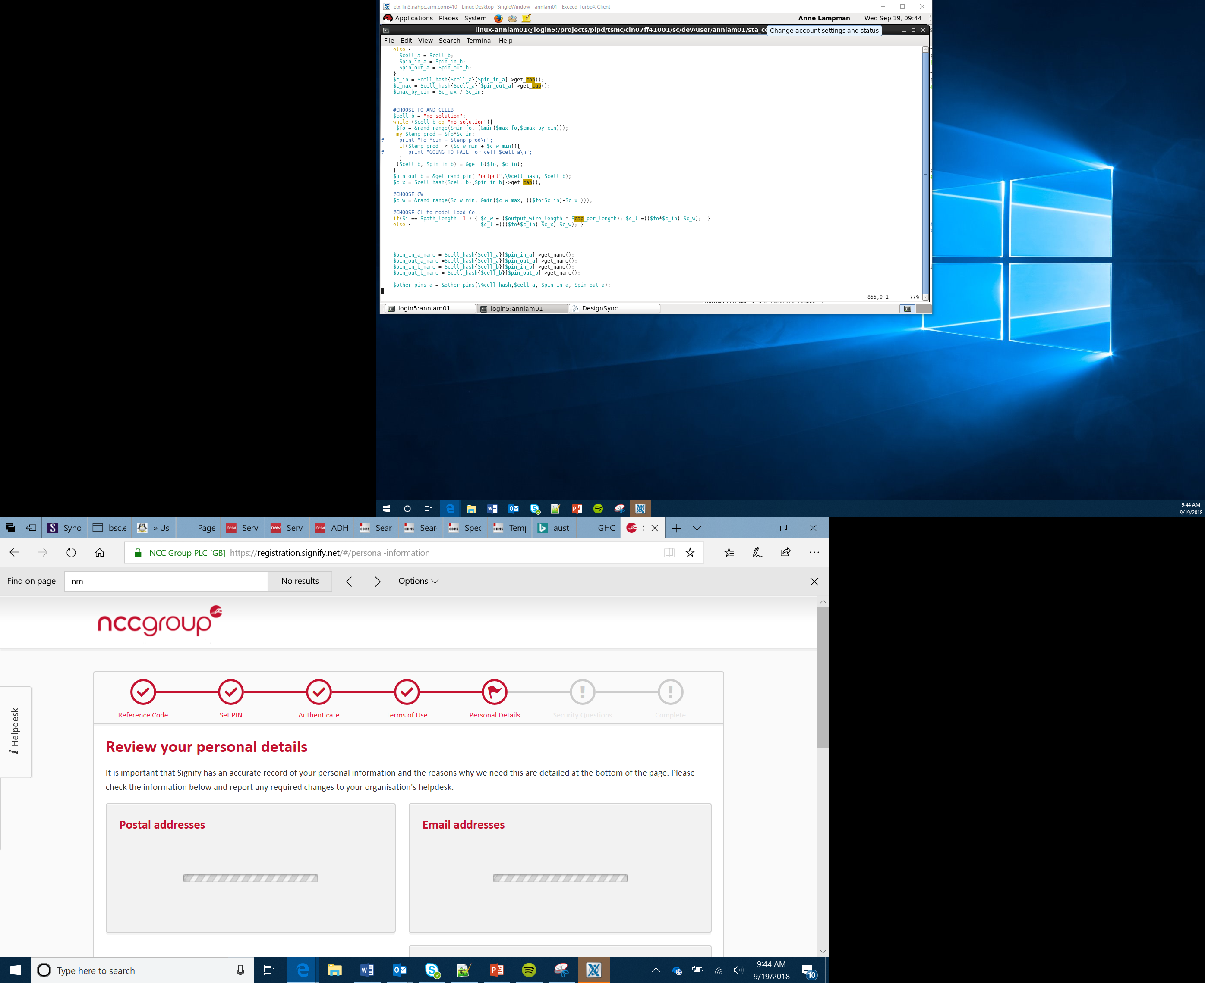

Disco Car
Lesson 6

Slide 2
Objectives
Apply your understanding of outputs and loops
Create a program to flash a single LED in a single colour
Create program to alternate the colour of a flashing LED eg red, blue, green (RGB)
Create a program that will rotate which LED is on and run down one arm of the Bit:Bot

Slide 3
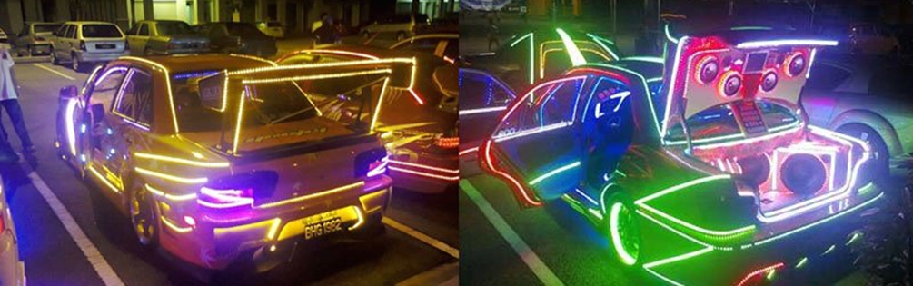
The Car Mod Scene
Throughout Europe and Asia there is a huge youth car culture based on modifying cars
This involves specialist body kits, big bore exhaust pipes and, of course, LED light shows
Spend some time looking online at the modification that can be applied to cars. Take a look at the YouTube videos https://www.youtube.com/watch?v=3tBnupnQxYg and https://www.youtube.com/watch?v=LnP_In85sWs for some examples
Notes:
Copyright image, can you get something similar?
Discuss the youth culture related to LEDs and CARS – This is quite popular in UK and Japan
Look at youtube videos and website on how people modify their cars. Why do they do this?
Nice video of LEDs on super cars at https://www.youtube.com/watch?v=3tBnupnQxYg and https://www.youtube.com/watch?v=LnP_In85sWs

Slide 4
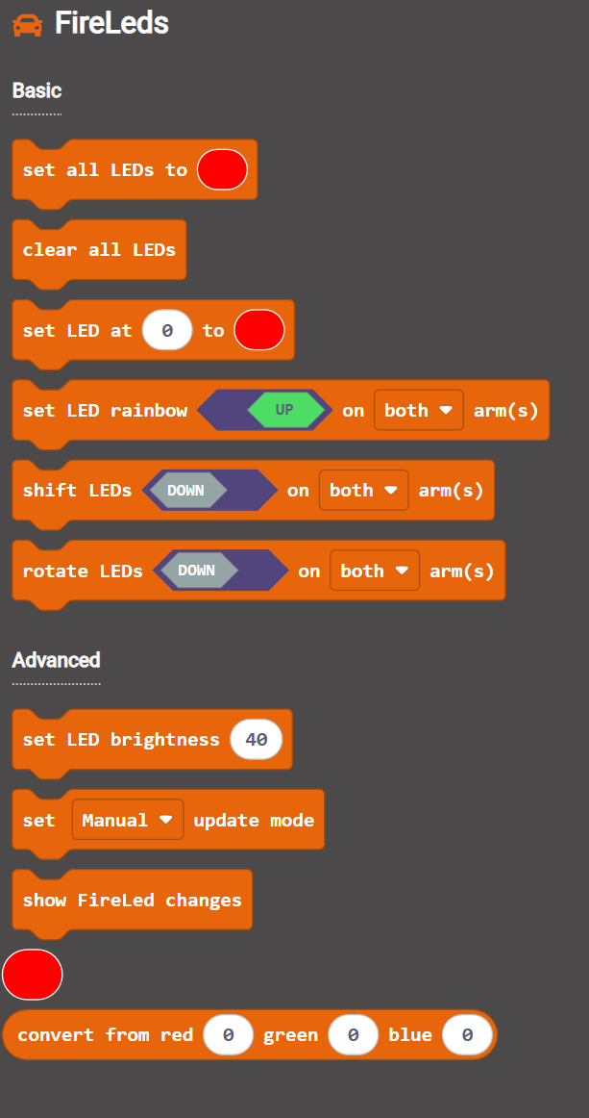
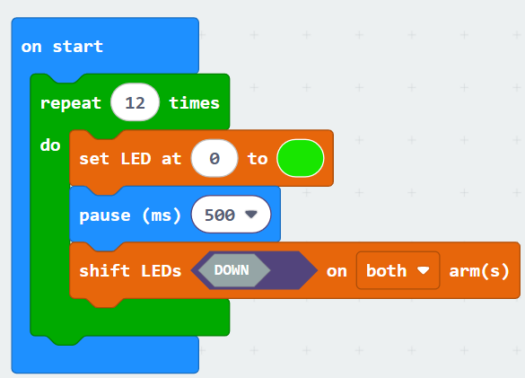
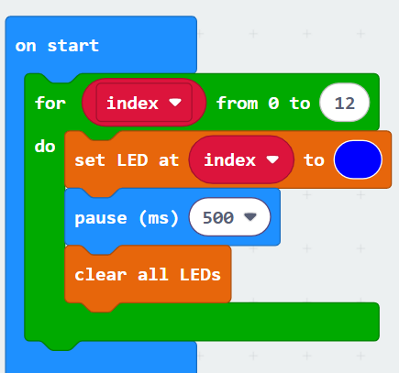
Disco Robot
The Neopixel LED comes with the Bit:Bot
Shift moves an LED forward and stops at the end but rotate keeps going around
We will now apply this knowledge to ‘mod’ our car and create a Disco Car
The examples on the left uses the Bit:Bot extension
Notes:
Consider how the use of LEDs on robotic cars could give warning messages in dark environments
Give the Learners the opportunity to be creative.
There should be no right or wrong here though Learners should be encouraged to use iteration over sequence in the coding
Remind Learners of the benefits of iteration and the difference between count controlled and condition loops

Slide 5
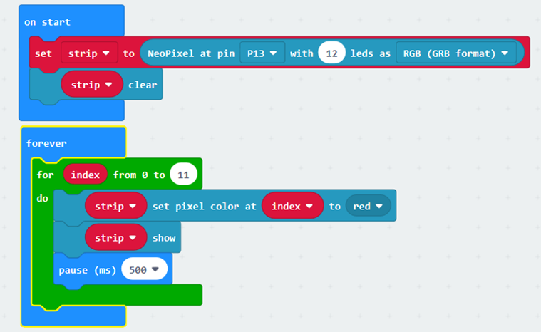
Disco Robot
The Neopixel can also be programmed directly using the NeoPixel extension.
Try this example:
Notes:
Demonstrate that Neopixel can be programmed directly, give some greater level of control, you just need to know the pin number and the number of LEDS in the strip

